Slide 1

Marketing
strategy

Slide 2
Agenda
##
Summary
##
Dataset
##
Model Strategy
##
Feature Importance
##
Extra Marketing Strategy

Slide 3

Technical Test, Data Science at loveholidays
At loveholidays our growth is driven by being able to attract visitors to our website where they can go on to purchase a great package holiday. We use data to make smarter decisions on where to invest our marketing budget and where to focus our effort to improve our user experience. In this task we would like you to analyse this data to build a predictive model of customer behaviour.

Slide 4
Dataset
attribution_path_data
user_feature_data
path_id: identifier column for which path the session is associated with.
device_type: the label encoded device type associated with the session.
attribution_channel: the label encoded marketing channel used to access our site for that session.
distance_to_last: the order of the sessions. A value of 1 denotes the last session in the path, and the max distance_to_last value denotes the first session in the path.
time_delta_in_days: the time difference in days between a given session and the last session in the path.
has_booked: the target variable which determines if a path ended with a booking. All sessions in a booked_path will have a value of 1 for this column.
path_id: the unique path identifier.
n_sessions: the number of sessions in the path.
most_common_landing_page: the most common landing page in the path.
clicked_x: whether a user clicked on a given website feature x (e.g. clicked_beach - the user clicked on a holiday to a beach destination).
viewed_x: whether a user viewed a given website feature x (e.g. viewed_beach).
saw_x: whether a user saw a given funnel page on our website (e.g. saw the price and availability page saw_panda).
adults: the average value inputted into the adults filter on the website.
children: the average value inputted into the children filter on the website.
nights: the average value inputted into the nights filter on the website.
Notes:
Ensure the titles are not duplicated. Please check the set of best practices.

Slide 5


Slide 6

Model Strategy
Predicting Booking Likelihood:
The classification model I've developed using the attribution_path_data and user_feature_data datasets can be used to predict the booking likelihood for individual users. This predictive capability can be integrated into the marketing automation system.
By assigning a booking probability score to each user, we can prioritize marketing efforts towards those with lower booking potential. This targeted approach allows to maximize the impact of the marketing resources.
Targeted Marketing:
Use the model to create a list of users who are most likely to book but haven’t converted yet, based on their past behaviour and demographic information.
Target this list of users with personalized email campaigns, social media ads, or retargeting ads.
This will help allocate the marketing resources more efficiently and maximize the return on investment (ROI).
Use the model to create a list of users who are not likely to book based on their past behaviour and demographic information.
Target this list of users with personalized email campaigns, social media ads, or retargeting ads where they are abandoning the system.
Retargeting:
Use the model to identify users who have abandoned the booking process at a specific stage, such as adding to a cart or entering payment information.
Retarget these users with specific marketing messages that encourage them to complete their booking.

Slide 7
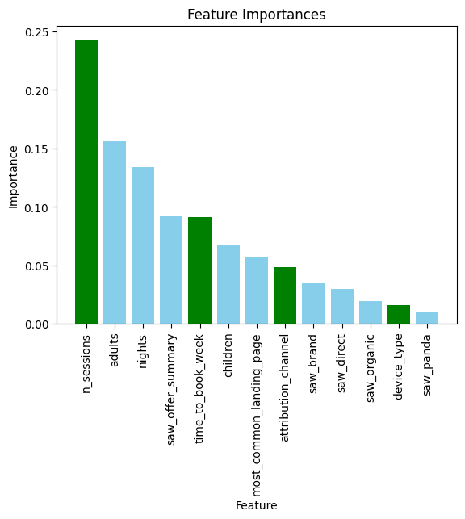
Feature Importance for marketing
Understanding the feature importance of a classifier model can be used to inform marketing strategies and potentially improve conversion rates
Here are some specific ways to leverage feature importance for marketing strategies:
Content Marketing:
Focus on “n_sessions” as that’s the most important feature, the user who has fewer “n_sessions” likely to not book send personalised ads or mails to them.
Focus on creating and promoting content that aligns with the features that have the most significant impact on booking decisions. For example, if ”saw_brand" is a key feature, emphasize brand-related content in blog posts, social media campaigns, and email newsletters.
Marketing Channel Optimization: Allocate marketing resources more strategically based on the features that influence users from different channels. If "attribution_channel" is important, prioritize marketing efforts on channels that drive users with high booking potential.
Predictive Analytics: Integrate feature importance into predictive models to refine the identification of high-potential customers. Use these predictions to prioritize marketing efforts and provide personalized messaging that addresses the features most likely to influence booking decisions.
Website Optimization: Prioritize improvements to the website's user interface, content, and functionality based on the most important features identified by the model. For instance, if ”saw_offer_summary" has high importance in terms of website data, ensure the summary is clear, easy to navigate, and highlights the value important summary of the trip.
A/B Testing: Utilize feature importance insights to develop A/B tests for different website elements, marketing messages, or targeting strategies. Experiment with variations that emphasize the key features to determine the most effective approaches.
By incorporating feature importance analysis into marketing strategies, marketers can make data-driven decisions that focus on the aspects that most significantly impact user behaviour and conversion rates. This can help optimize marketing efforts, improve user engagement, and ultimately drive business growth.
attribution_path_data
user_feature_data

Slide 8

Extra Strategy
Personalized Marketing:
Use the model to identify the specific features and benefits that are most important to each user.
Tailor the marketing messages to highlight the features and benefits that are most relevant to each user.
Predictive Analytics:
Use the model to predict which users are most likely to book in the next 7 days, 14 days, or 30 days.
Proactively reach out to these users with pre-emptive marketing messages that encourage them to book now.
Identifying High-Potential Customers:
By analyzing the characteristics of booked_paths (i.e., paths that ended with a booking), we can identify patterns and trends that indicate high booking potential. This could include specific device types, attribution channels, time deltas, or user features that frequently appear in booked_paths.
Once identified these patterns, we can use them to target the marketing efforts towards those who are less likely to book. This could involve tailoring the messaging, promotions, or offers based on the identified characteristics.
Optimizing Marketing Channels:
The attribution_channel column in the attribution_path_data dataset can help assess the effectiveness of different marketing channels. By comparing the frequency of different channels in booked_paths versus non-booked paths, can determine which channels are driving the most bookings.
Focus the marketing resources on the channels that have proven to be most effective, while reevaluating the strategies for channels that are not yielding desired results.

Slide 9


